Slide 1


KENYAN HIGHER EDUCATION
UNI ARCHIVE
Intelligent Academic Document Retrieval for Kenyan Universities
Revolutionizing access to academic materials through OCR and Semantic Search technology

Slide 2
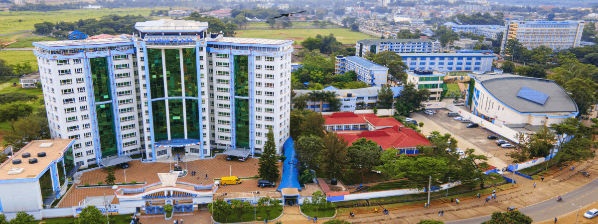
PRESENTATION OVERVIEW
Agenda
01
The Challenge
Fragmented resources in Kenyan higher education
02
Our Solution
UNI ARCHIVE platform features and objectives
03
System Architecture
Technical design, workflows, and technologies
04
Impact & Roadmap
Implementation timeline and expected outcomes

Slide 3
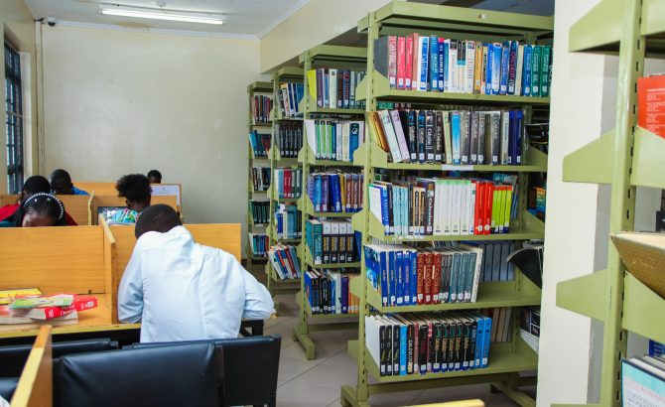
01
The Challenge
Fragmented academic resources in Kenyan higher education

Slide 4
THE CHALLENGE
Fragmented Academic Resources
Kenyan university students face significant barriers accessing materials:
Geographic & Temporal Barriers
Fragmented Distribution
Limited library access due to distance, operating hours, and physical capacity constraints.
Materials scattered across personal drives, WhatsApp groups, and informal sharing networks.
Unsearchable Content
Weak Metadata
Scanned documents and PDFs lack machine-readable text, making content impossible to search.
Inconsistent categorization and lack of standardized metadata hinders resource discovery.
The Result: Students waste hours searching for materials, collaboration is hindered, and valuable academic content remains buried and inaccessible across Kenyan universities.

Slide 5

02
Our Solution
UNI ARCHIVE — Built for Kenyan higher education

Slide 6

OUR SOLUTION
Introducing UNI ARCHIVE
Intelligent Search
Combines traditional keyword-based search with advanced semantic understanding for highly relevant results.
OCR Text Extraction
Transforms previously inaccessible scanned documents into fully searchable and editable text content.
Centralized Management
Secure web-based platform storing all course readings, research papers, and institutional documents.
A revolutionary platform designed to overcome the challenges faced by Kenyan university students in accessing academic materials.
Goal: Streamline academic workflow, making research efficient and accessible.

Slide 7
KEY OBJECTIVES
What We Aim to Achieve
Centralized Resource Mgmt
Intelligent Text Extraction
Hybrid Search System
Develop a secure web platform with hierarchical academic metadata structure.
Implement OCR with preprocessing for enhanced accuracy on scanned documents.
Combine keyword (BM25) and semantic (Sentence-BERT, FAISS) search.
Duplicate Detection
RAG-Inspired Pipeline
Performance Evaluation
Use perceptual hashing (pHash) to prevent redundant storage of documents.
Adapt Retrieval-Augmented Generation for resource-constrained environments.
Measure effectiveness using CER, WER, nDCG@10, and MRR metrics.
All objectives designed with Kenyan university constraints in mind — low bandwidth, limited compute, and diverse document formats.

Slide 8
COMPETITIVE ANALYSIS
UNI ARCHIVE vs Existing Systems
System | Limitations | UNI ARCHIVE Advantage
Google Drive | No academic metadata structure; limited semantic search & duplicate detection; fragmented access control | Hierarchical academic organization; hybrid semantic + keyword search; perceptual hashing for deduplication
University Library Repos | Focus on faculty research only; manual cataloguing bottlenecks; limited OCR integration & traditional IR | Supports teaching materials & student contributions; automated processing pipeline & modern semantic retrieval
DeepTutor (AI) | High computational complexity & LLM dependency; risk of hallucination & scope creep; complex deployment | Lightweight, deterministic, focused retrieval; simple deployment in resource-constrained environments
Informal Sharing | No organization, searchability, or metadata; redundant storage & limited access control | Centralized searchable repository & academic categorization; version control & universal access by enrollment
UNI ARCHIVE is the only solution designed specifically for Kenyan university resource constraints

Slide 9

03
System Architecture
Technical design, workflows, and technologies powering UNI ARCHIVE

Slide 10
SYSTEM WORKFLOWS
How UNI ARCHIVE Works
1. Document Processing
Upload
Preprocess
OCR
Review
Deduplicate
Documents uploaded, processed via OCR with quality checks, and deduplicated before storage.
2. Storage & Indexing
Validate Docs
Relational Store
Embed Text
Vector Index
Validated documents stored relationally, with embeddings and full-text indexes for efficient retrieval.
3. Search & Retrieval
User Query
Parse Query
Parallel Search
Fuse Results
Present Results
User queries trigger parallel keyword and semantic searches, with results fused for optimal relevance.

Slide 11
TECHNICAL STACK
Technologies & Tools
Built on a robust, modern stack leveraging cutting-edge open-source technologies.
Frontend: React & TypeScript
Backend: Python & FastAPI
Database: PostgreSQL
Delivers a dynamic, responsive, and type-safe user interface for seamless interaction with the archive.
Powers the high-performance API and business logic, ensuring rapid processing and scalable operations.
Securely stores all academic metadata and document references with robust relational data management.
ML/AI: Sentence-BERT & FAISS
OCR: Tesseract
Enables advanced semantic search and efficient vector indexing for intelligent document retrieval without external LLM dependencies.
Extracts accurate, searchable text from scanned documents, making previously inaccessible content available for search and retrieval.

Slide 12
SECURITY & DATA MANAGEMENT
Security & Data Governance
Ensuring integrity, confidentiality, and availability of academic data through robust measures.
Access Control
Data Encryption
Privacy Compliance
Role-based permissions limit access to sensitive documents, ensuring only authorized users can view content.
All data encrypted both at rest (on storage servers) and in transit (during transmission).
Adherence to data privacy regulations like GDPR and specific institutional policies.
Audit Logging
Backup & Recovery
Comprehensive audit trails track all user activity, providing accountability and enabling investigation.
Regular backups and robust recovery procedures ensure data redundancy and business continuity.
All security measures designed to protect student academic data while ensuring seamless access to authorized users.

Slide 13

04
Impact & Roadmap
Project feasibility, implementation timeline, and expected outcomes

Slide 14

IMPLEMENTATION ROADMAP
14-Week Development Plan
WEEKS 1-4
WEEKS 5-9
WEEKS 10-12
WEEKS 13-14
Platform Setup & OCR
Semantic Search
Testing & Refinement
Deployment
Establish core infrastructure, set up databases, integrate the OCR engine, and enable basic document upload functionality.
Integrate Sentence-BERT for embeddings, implement FAISS for vector indexing, and develop the hybrid search API.
Conduct internal testing, gather user feedback, make UI/UX improvements, resolve bugs, and fine-tune performance.
Launch to production, develop user training materials, establish continuous monitoring, and set up support.
Total Estimated Cost: KES 8,000
Utilizing open-source tools with minimal external costs
Feasible within academic constraints
No complex LLM dependencies | Academic-specific IR

Slide 15
EXPECTED OUTCOMES
Benefits for All Stakeholders
For Students
For Faculty
For the Institution
90% Faster
Easier Sharing
Secure Archive
document retrieval speed
of research & teaching materials
with reduced administrative burden
Instant access to academic materials, significantly reducing research time. Enjoy 24/7 access to a comprehensive digital library from any device.
Streamlined resource management and secure content contribution. Enhanced collaboration tools across departments.
Long-term preservation of academic knowledge. Improved operational efficiency with a unified resource hub.
UNI ARCHIVE delivers measurable impact, enhancing academic processes for all stakeholders in Kenyan higher education.

Slide 16
UNI ARCHIVE
Transforming Kenyan Higher Education
Empowering students, faculty, and institutions with intelligent document retrieval. Built for Kenya, ready for deployment.
Learn More

